Slide 1
EECE 5698
Robotics Sensing and Navigation
Homework 5 Data Analysis

Slide 2
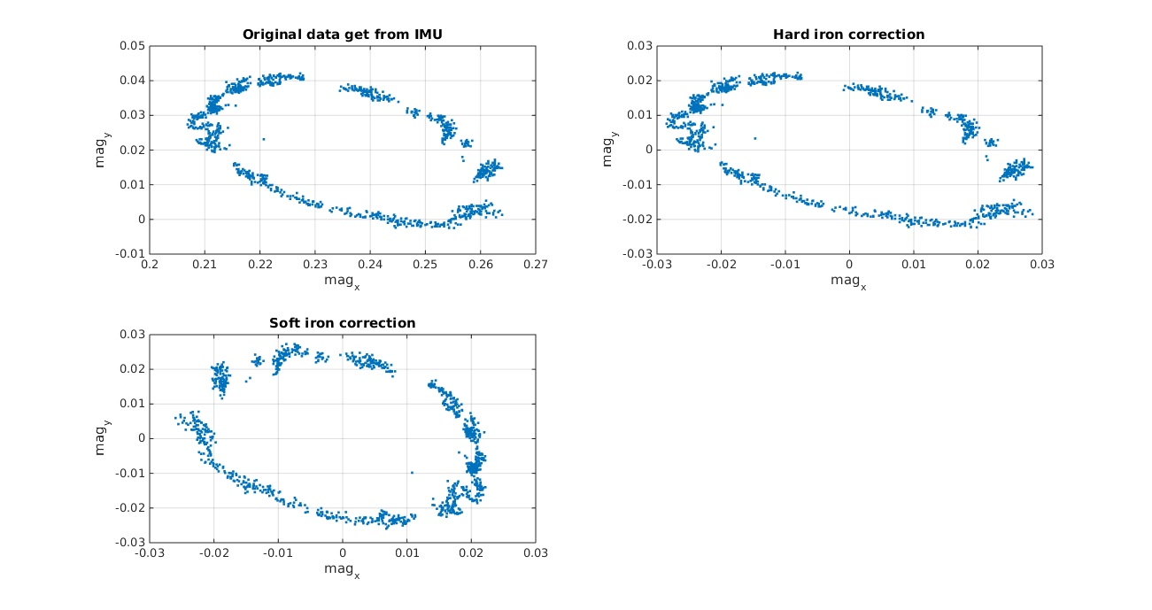
“Hard-iron” & “Soft-iron” compensation
Hard-iron distortion is produced by materials that exhibit a constant, additive field to the earth's magnetic field, thereby generating a constant additive value to the output of each of the magnetometer axes.
Hard iron compensation is accomplished by determining the x and y offsets and then applying these constants directly to the data.
Soft-iron distortion is the result of material that influences, or distorts, a magnetic field—but does not necessarily generate a magnetic field itself, and is therefore not additive.
Followed by the procedures found online, I was able to transform it from ellipse to a “circle”, and it’s symmetric on both x-axis and y-axis.
It’s worthy to note that if tilt and hard-iron effects are present, compensation for these distortions must be applied prior to correcting for soft-iron distortions

Slide 3
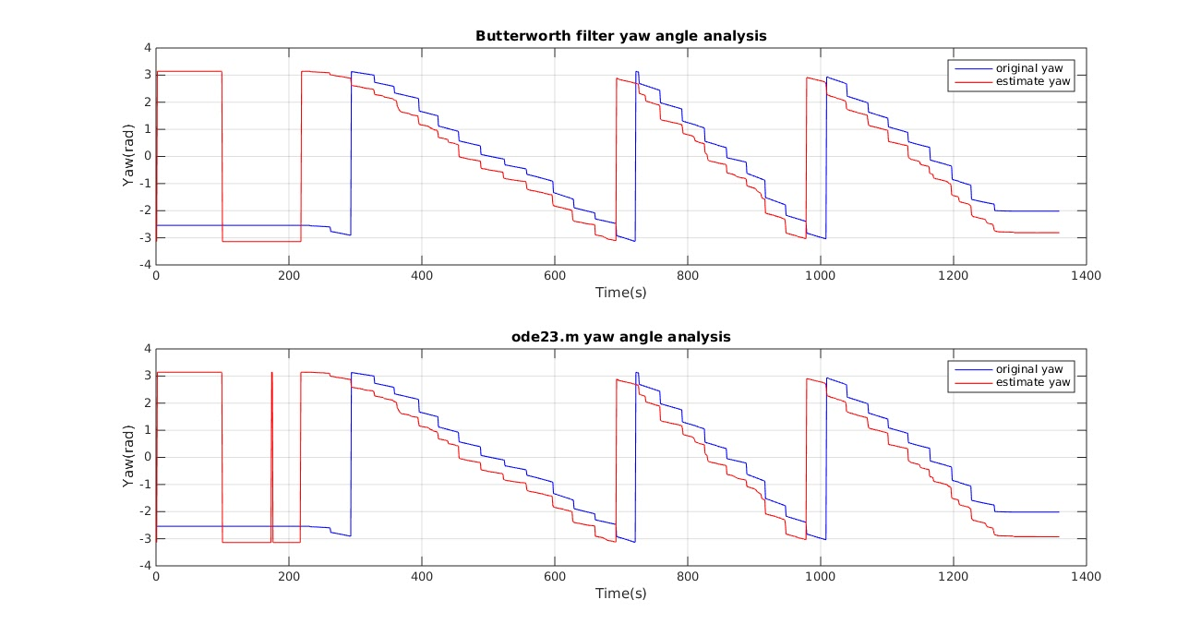
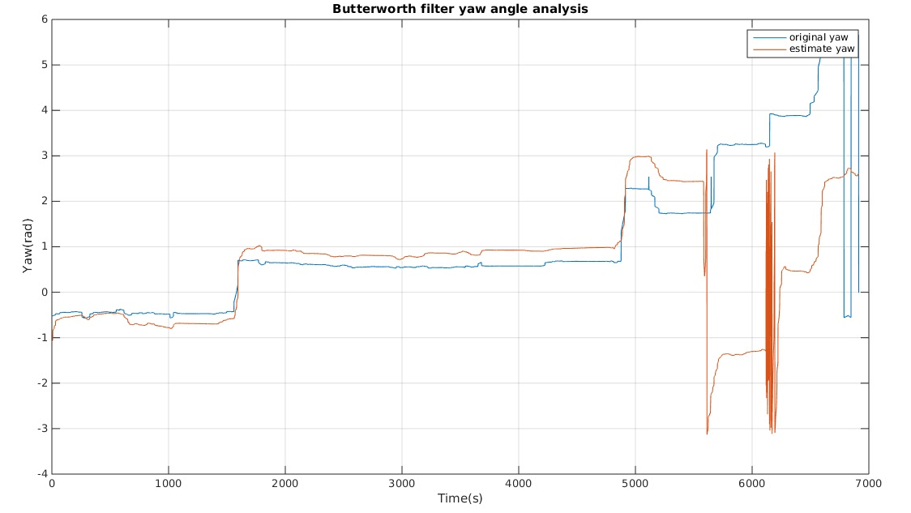
Yaw angle estimation
By integrating the yaw angle, we would be able to get an estimation of yaw angle.
First method: butterworth lowpass filter
Key parameter: sampling frequency - 40Hz, cutoff frequency - 10Hz.
Result analysis: as we can seen from the top figure, the blue curve shows the original yaw angle, while the red shows the estimation value.
There is a constant shift between the estimation and original value, it can be caused by the choice of cutoff frequency.
I also plotted the butterworth lowpass filter for the drive path data, it seems like there is slight shift with the original data.
Second method: ode23.m Key parameter: tspan - use the timestamp get from IMU data collection
Result analysis: similar with butterworth lowpass filter, there is another shift between original value and estimated value.

Slide 4
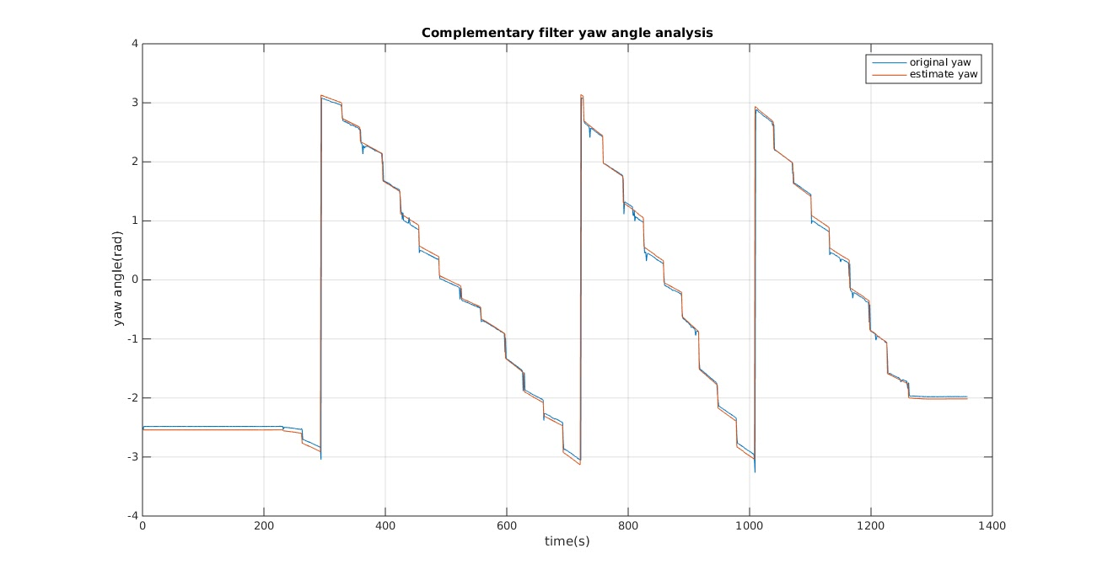
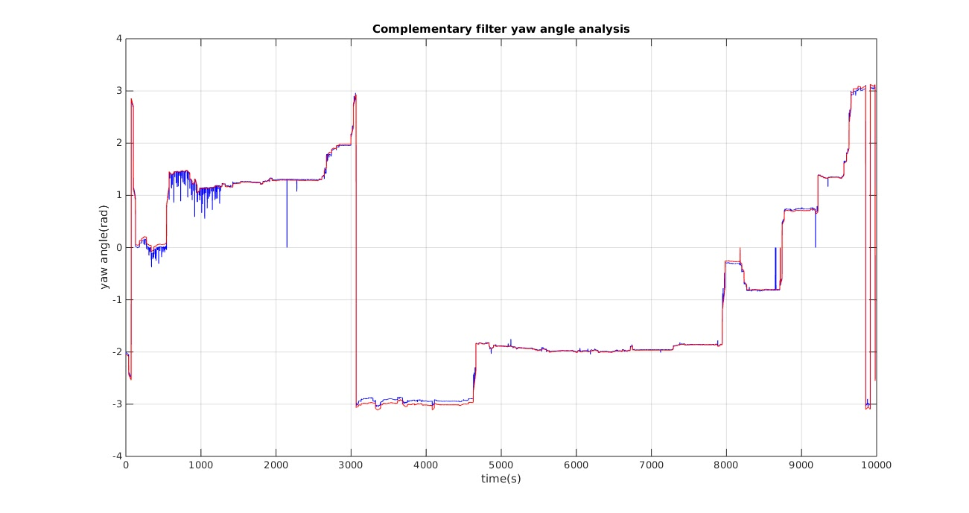
Yaw angle estimation II
By using the equation provided in the reference manual, I would able to use a complementary filter to combine the measurement result from magnetometer and yaw rate as input to get the estimated value of yaw angle.
As it can be seen from the top figure, the estimated yaw angle is almost the same with the original one, in which shows that it’s a improved estimate of yaw angle.
I also applied the same contemporary filter to the long driving path data to get an estimation, it is also a match.

Slide 5
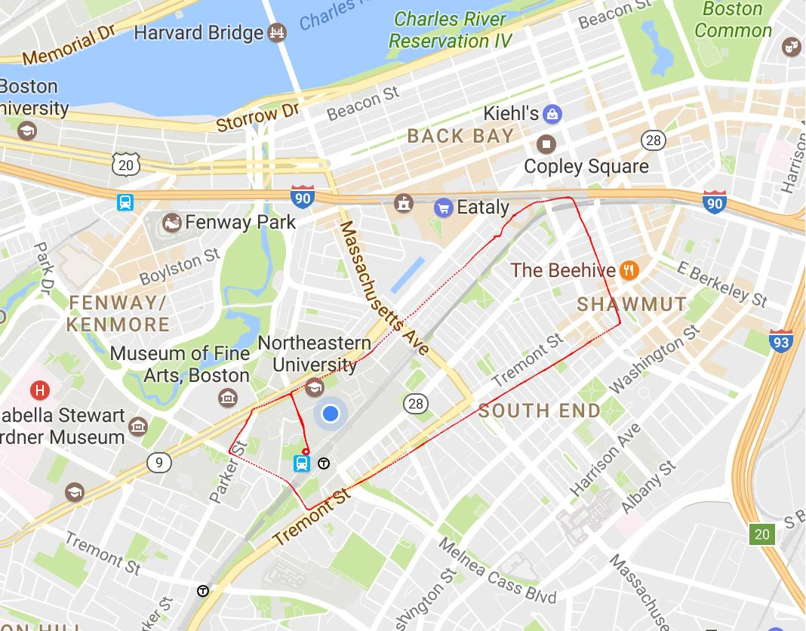
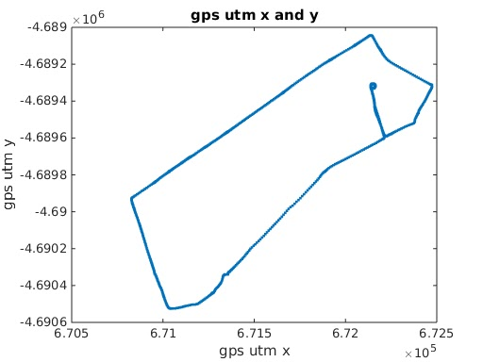
Utm_x vs. utm_y
From the GPS receiver, we collected utm_x and utm_y data. And by convention, we would need to put a negative sign if the latitude is south or the longitude is north.
To help visualize our data, we put the shape of our utm_x vs.utm_y data on the Google map, and it seems that it mostly matches with our route.
So from that, we may conclude that our GPS receiver is totally functionally working properly, and there is no major error during the procedure of data collecting for GPS receiver.

Slide 6
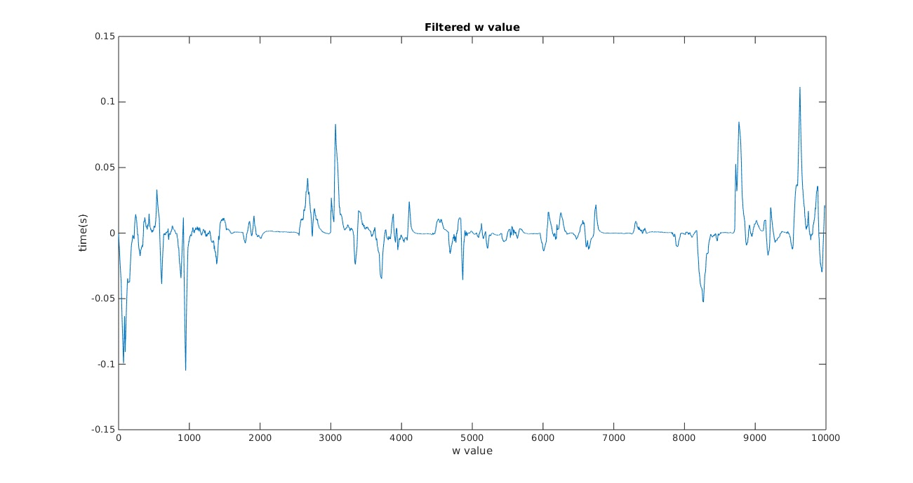
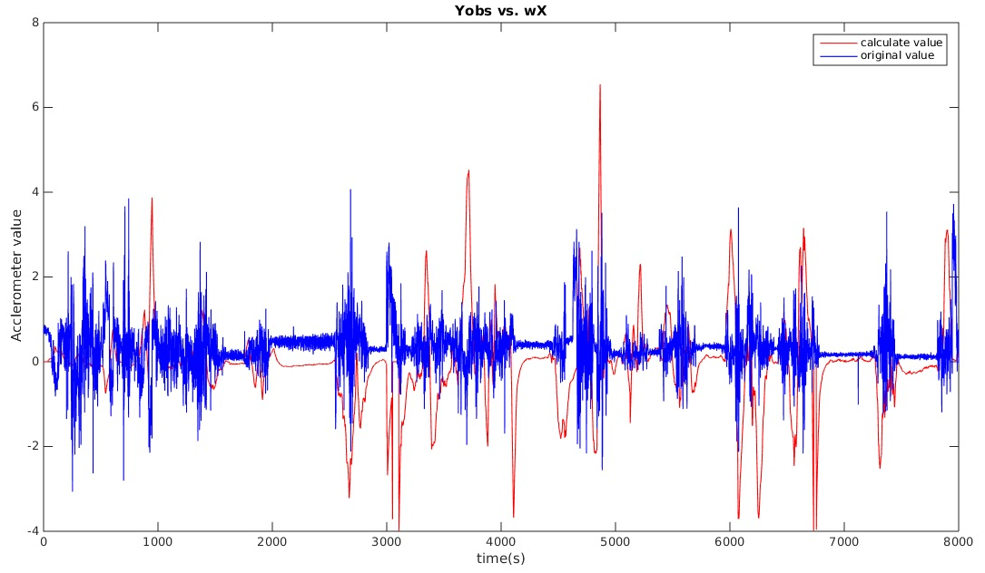
Yobs calculation/estimation
Before conducting the integration of x’’ value, i figured out that there are some outlier in the ယ(gyro_z) value.
So I filter those points off by using another butterworth lowpass filter with an extremely high cutoff frequency. And the top figure shows the ယ(gyro_z) value after filtering.
The bottom figure shows a comparison between calculated value. While the original yobs(acc_y value) is shown in blue.
Result analysis: from what I seen in the figure, the difference between estimation and original value is not too big. But it seems like there is still a lot of “noise” like signal points in both data, so maybe an additional filter should be applied to make the data looks clean.
The difference between two value can come from the noise while collecting the data using IMU, the error from gyros or the manual error during the procedure of data collection.

Slide 7
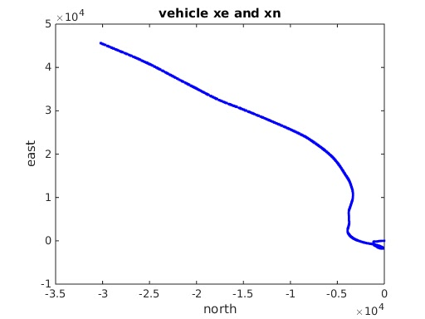
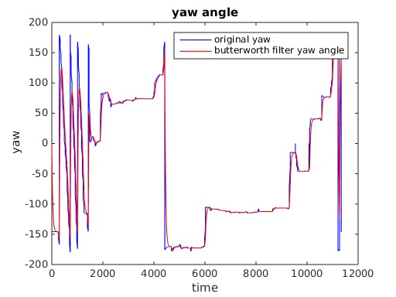
Trajectory of vehicle
Before conducting the integration of x’’ value, i figured out that there are some outlier in the yaw angle value.
So I filter those points off by using another butterworth lowpass filter with an extremely high cutoff frequency. And the bottom figure shows the yaw angle value after filtering.
For the trajectory of vehicle, I followed the equation listed in the equation sheet.
But for some reason, I could not even get a match with the GPS track data (utm_x vs. utm_y)
I think the error could come the place we put GPS receiver and IMU while receiving the data or simply could be a misunderstanding concept or miscalculation.

Slide 8
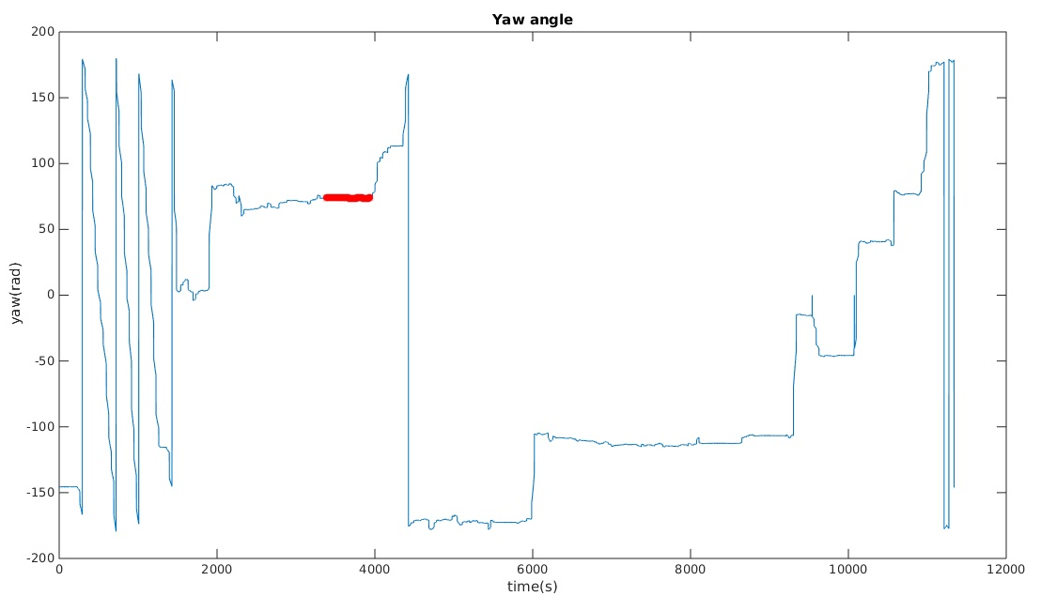
Xc value estimation
By using the equation provided in the homework sheet, I got xc = 1.9423m (the unit is found in the reference manual)
There is still some error in the data calculation, for which can be come from noise while conducting the measurement, or the region choice.
For the region choice, I tried to get a flat period in the yaw_angle, but in practise, it could not be totally flat at all.
Usually, the length of a car is 3-4m, so saying that the imu is mounted on the half length of car would make sense to me.

Slide 9
Reference
http://www.sensorsmag.com/sensors/motion-velocity-displacement/compensating-tilt-hard-iron-and-soft-iron-effects-6475
http://www.vectornav.com/docs/default-source/documentation/vn-100-documentation/UM001.pdf?sfvrsn=12
https://sites.google.com/site/myimuestimationexperience/filters/complementary-filter

